Slide 1


EENG385 - Electronic Devices and Circuits
Lecture 03:
Deboo Integrator
Objective:
The objective of this lab is to introduce you to the operation of the Deboo Integrator and its interactions with 555 Timer and Schmitt Trigger Relaxation Oscillator to create a staircase voltage waveform.
1

Slide 2
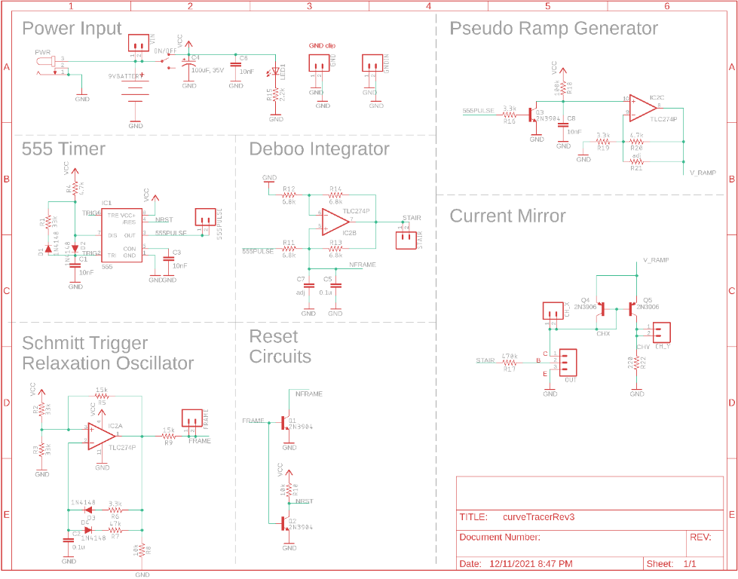
BJT Curve Tracer
Deboo Integrator interacts
555 Timer to provide voltage
Schmitt Trigger to reset integrator
2
2
Notes:
2

Slide 3
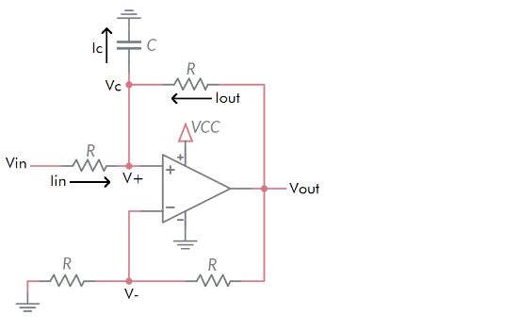
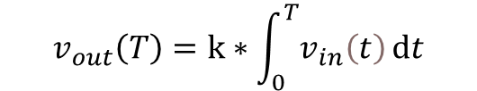
Deboo Integrator
$$v_{out}\left(T\right)=k∗\int_{0}^{T}{v_{in}\left(t\right)ⅆt}$$
k will depend on R and C
3
3
Notes:
3

Slide 4
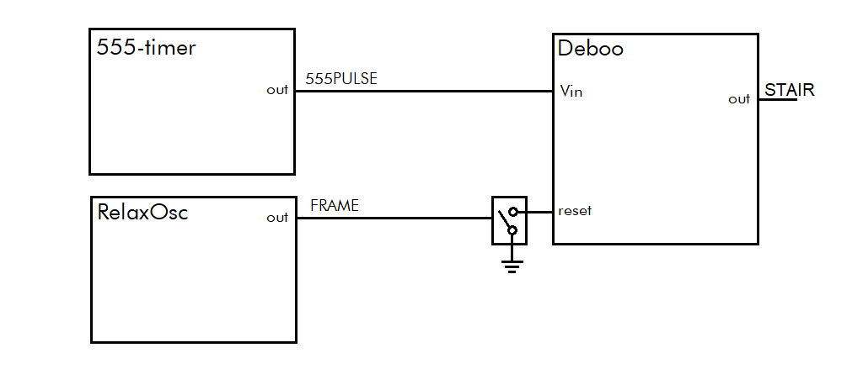
Architecture
Deboo Integrator
Integrates 555PULSE creating a staircase waveform
Output voltage reset on high pulse from Schmitt Trig Relax Osc
4
4
Notes:
4

Slide 5
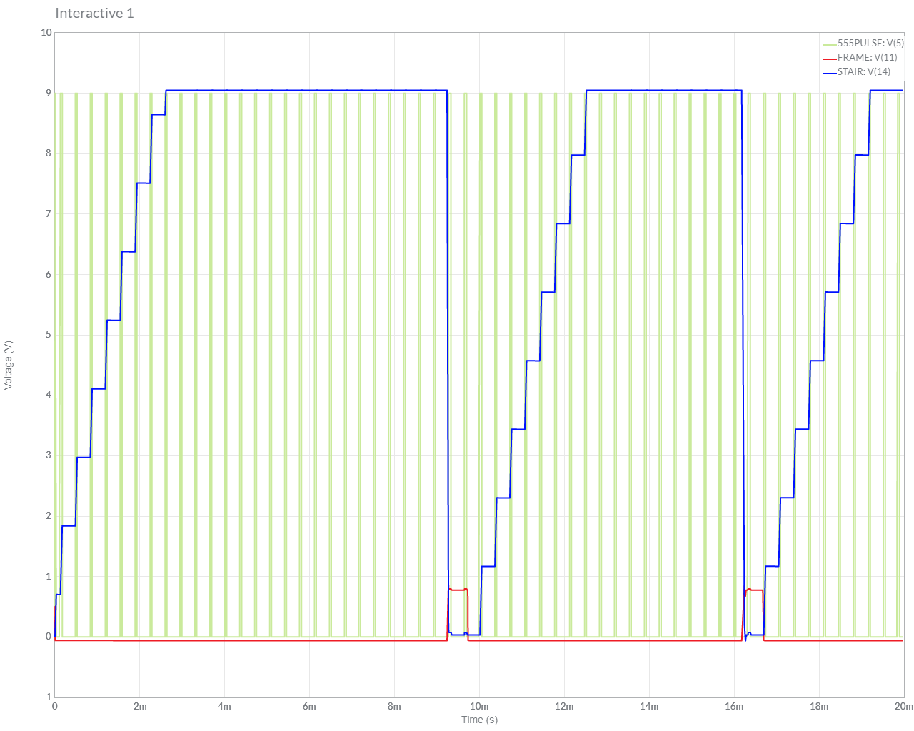
Simulate
Start with Lab 1 or Lab 2 circuit, add components
Set initial conditions on capacitor
5
5
Notes:
5

Slide 6
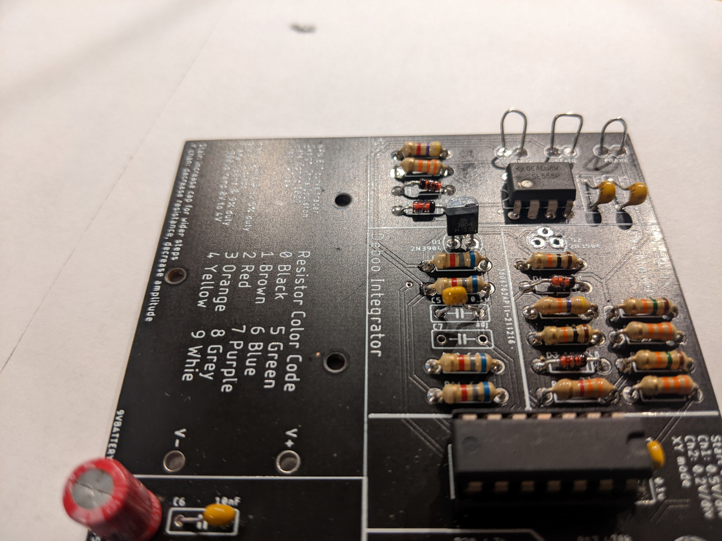
Assemble
Transistor is polarized
Leave capacitor C7 empty – for now
6
6
Notes:
6

Slide 7
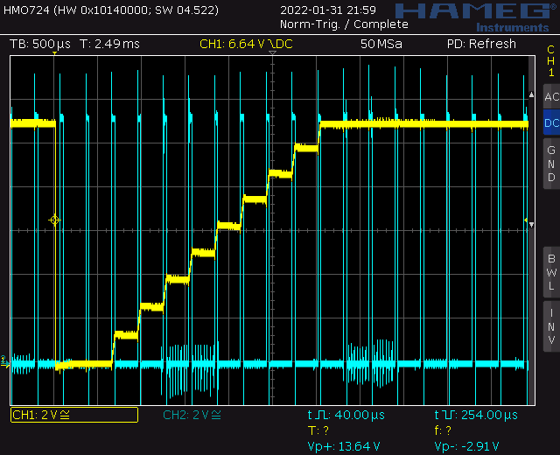
Test
Probe 555TIMER (blue) and STAIR (yellow)
Noisy power supply created chaos
7
7
Notes:
7

Slide 8
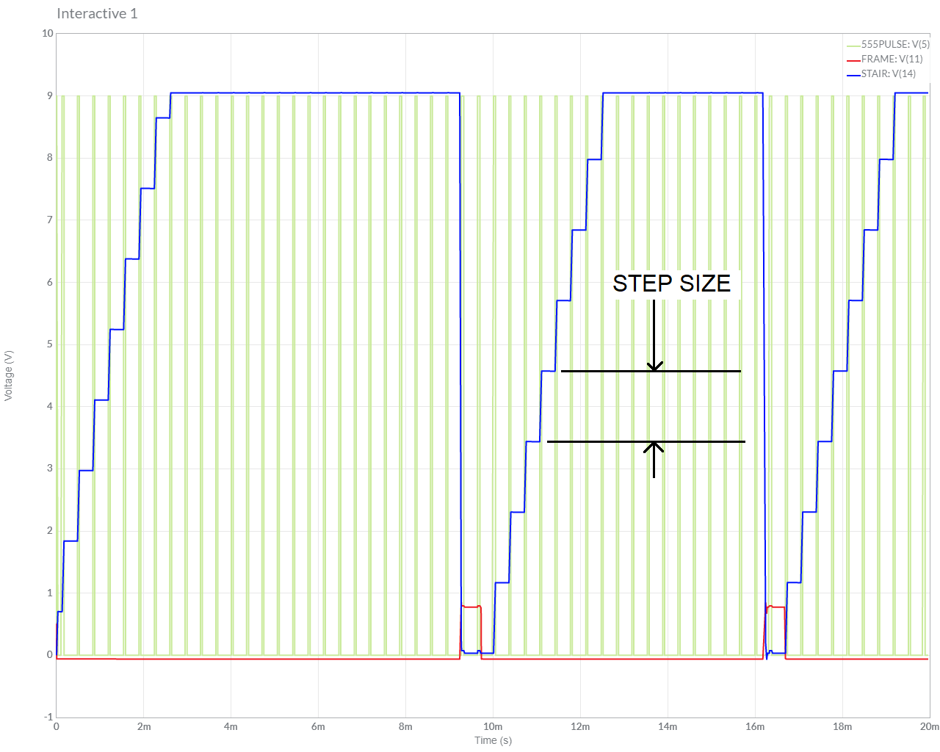
Turn in
Summary of analysis, simulation and assemble
Table 2 Step Size
8
8
Notes:
8

